Slide 1
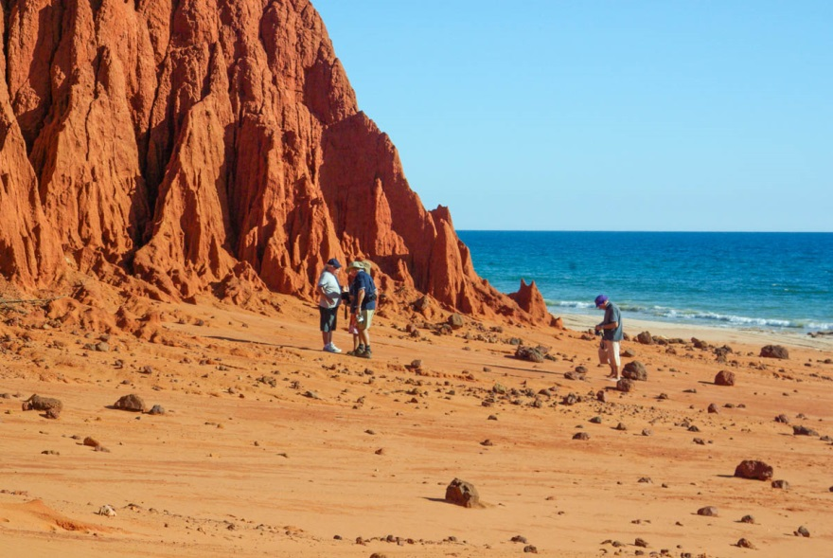
Coastal landforms

Slide 2
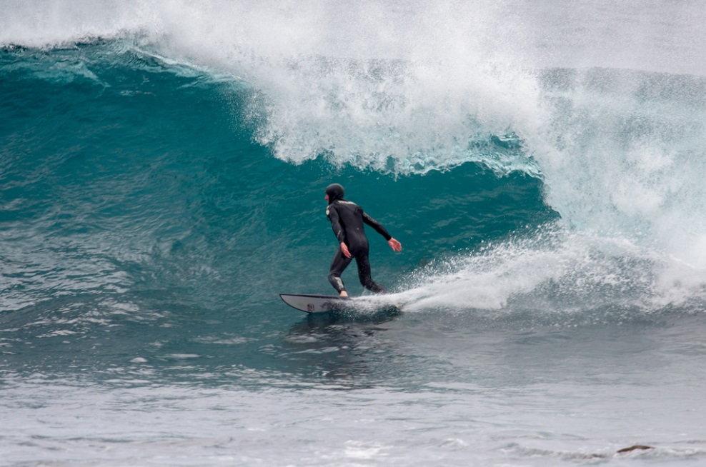
Coastal landforms are shaped by the currents, waves, winds and storms.

Slide 3
This landform is called a beach. Why does the beach have a gentle slope?

Slide 4
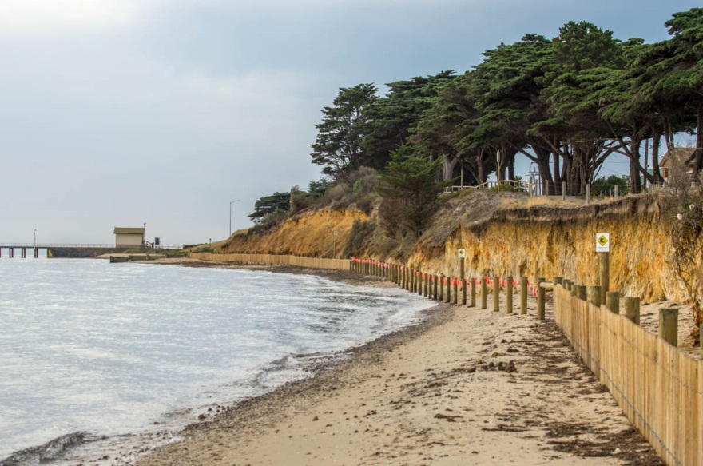
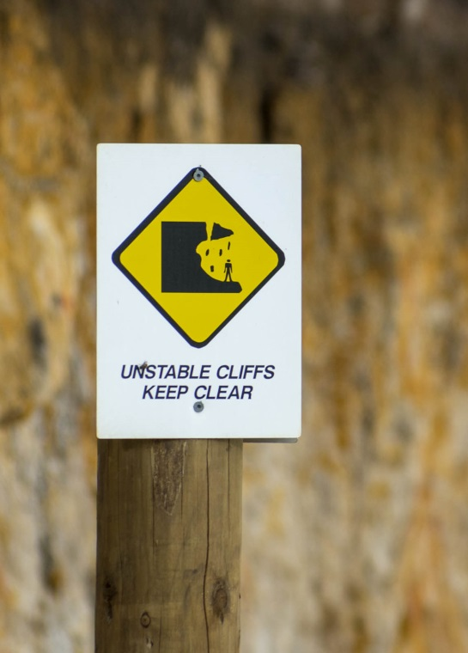
How are the waves and storms affecting this beach?

Slide 5
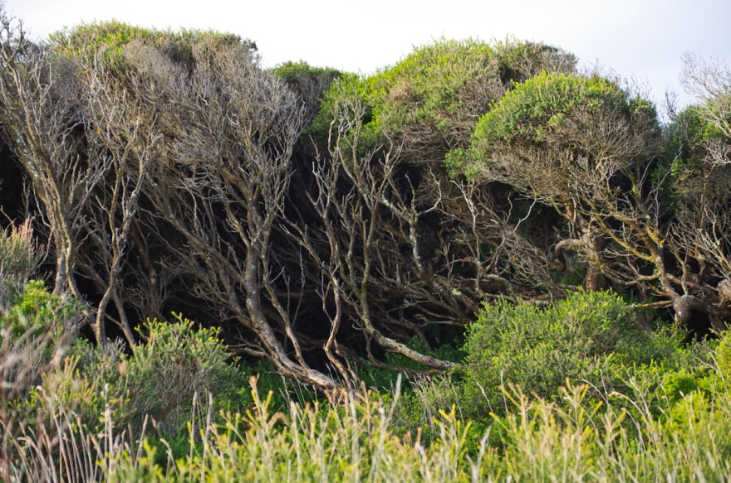
What can you see that shows this beach is windy?

Slide 6
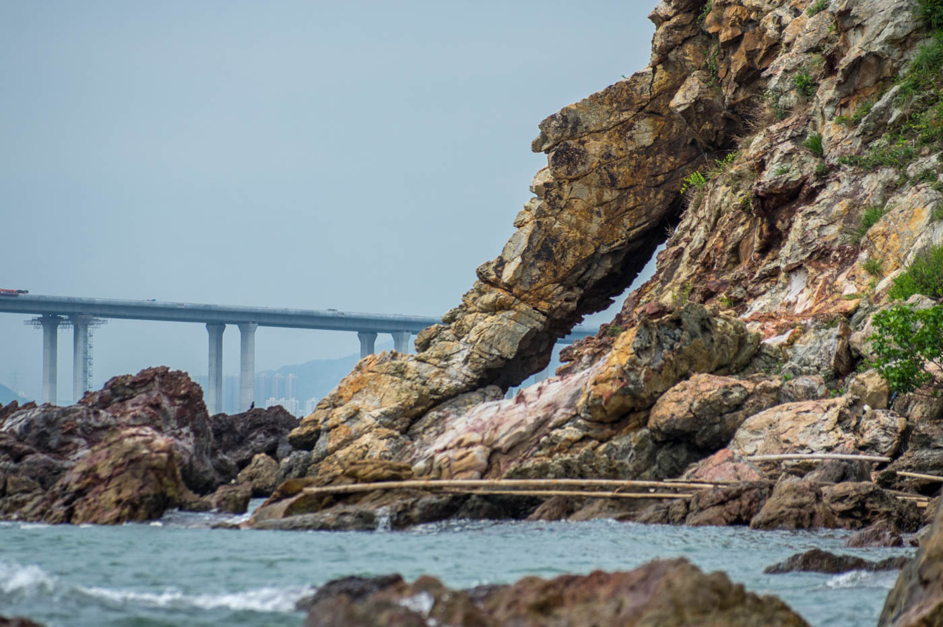
This landform is a cliff. What is it made from?

Slide 7
What is this cliff made from? Which cliff is more affected by the weather and sea?

Slide 8
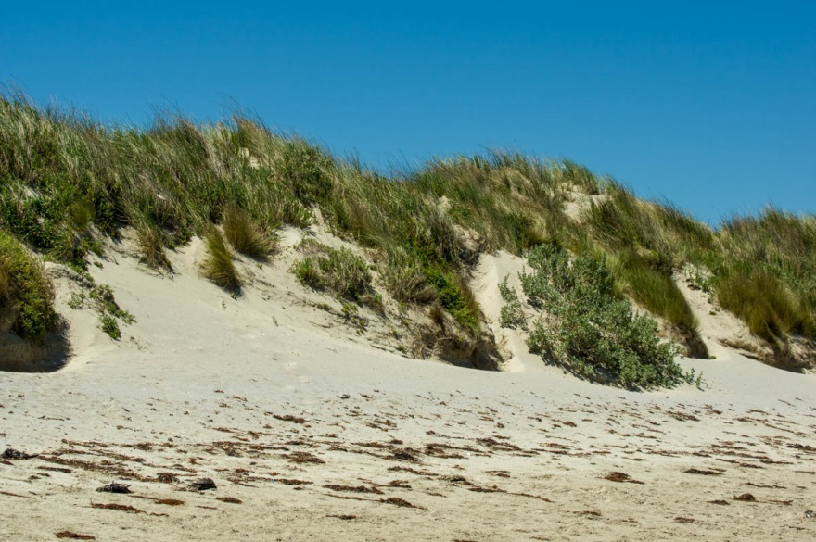
This landform is a sand dune. What is holding the sand together?

Slide 9
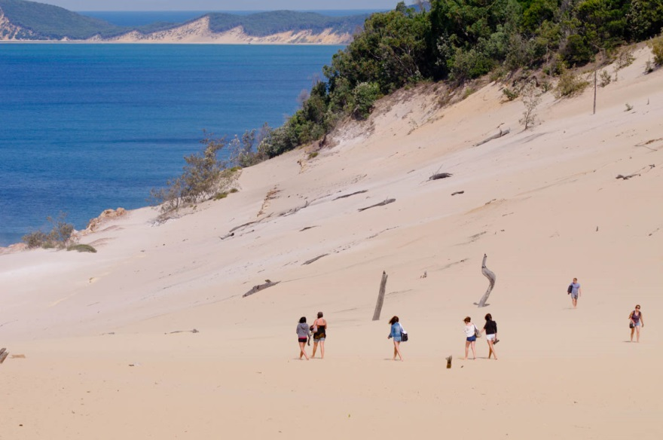
Discuss how you might calculate the size of this sand dune.

Slide 10
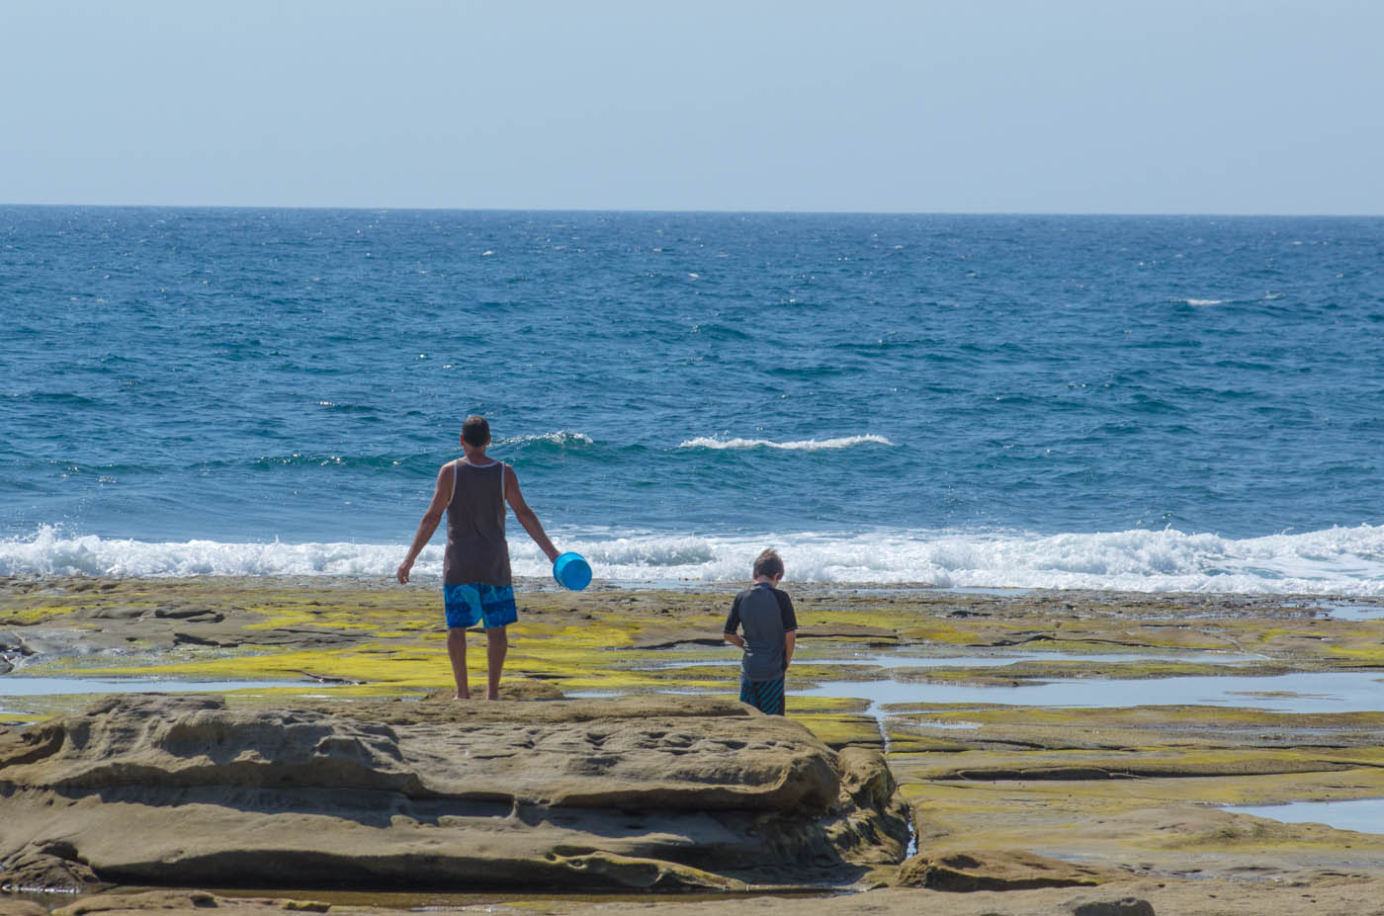
This is a rocky platform. How is it different to a beach?

Slide 11
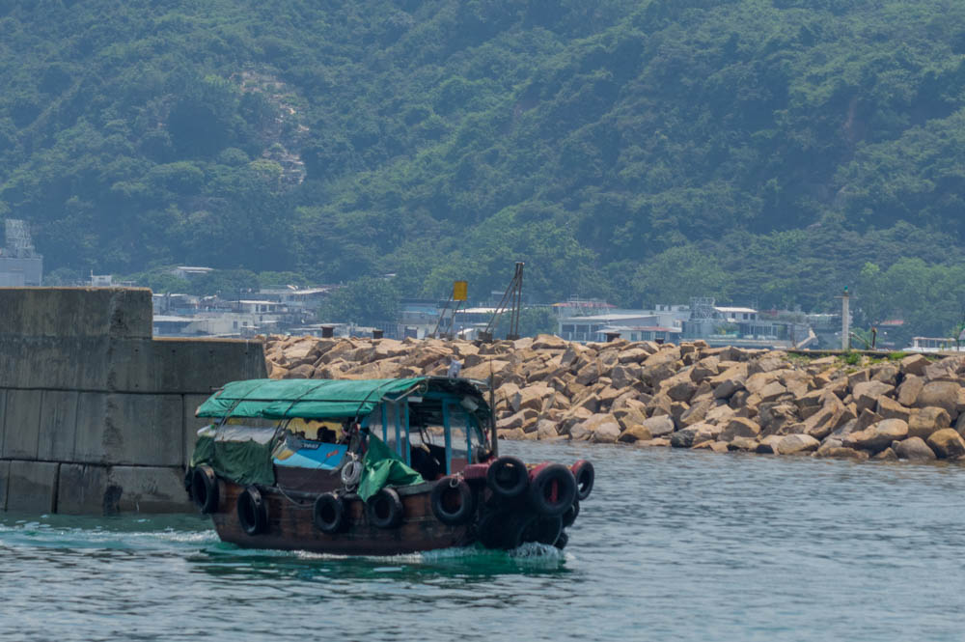
How has this coastal area been modified?

Slide 12
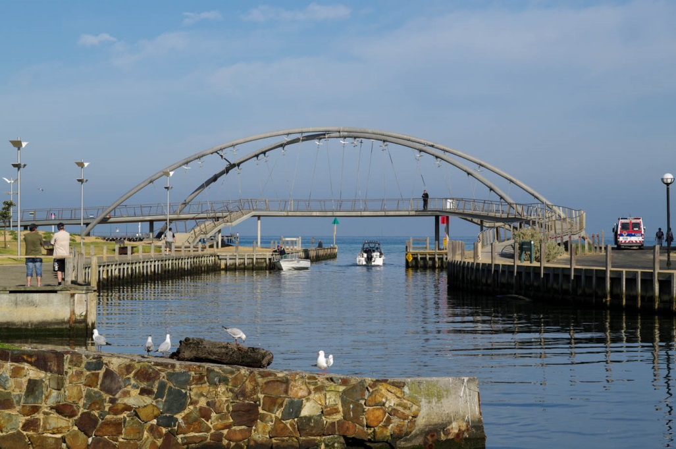
This creek is entering the sea? How have people managed the creek?

Slide 13
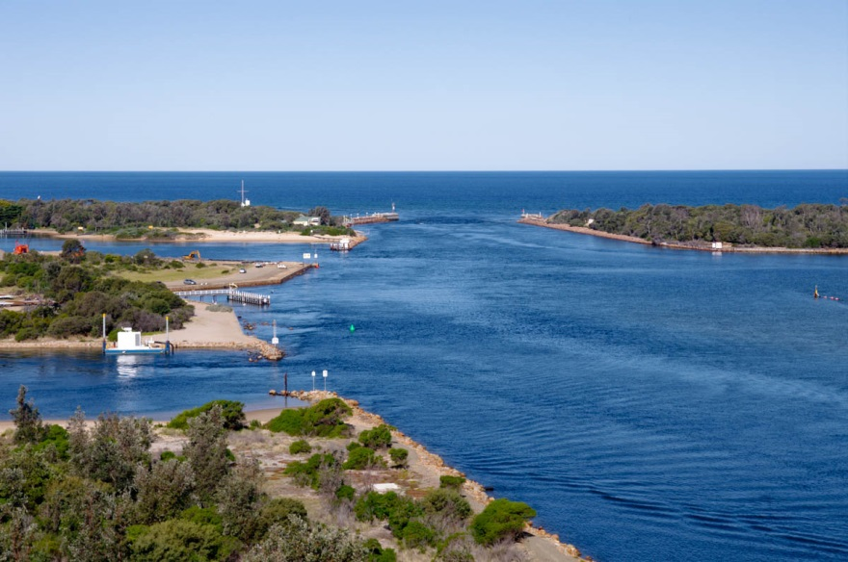
These lakes are entering the sea. How have people managed the entrance?

Slide 14
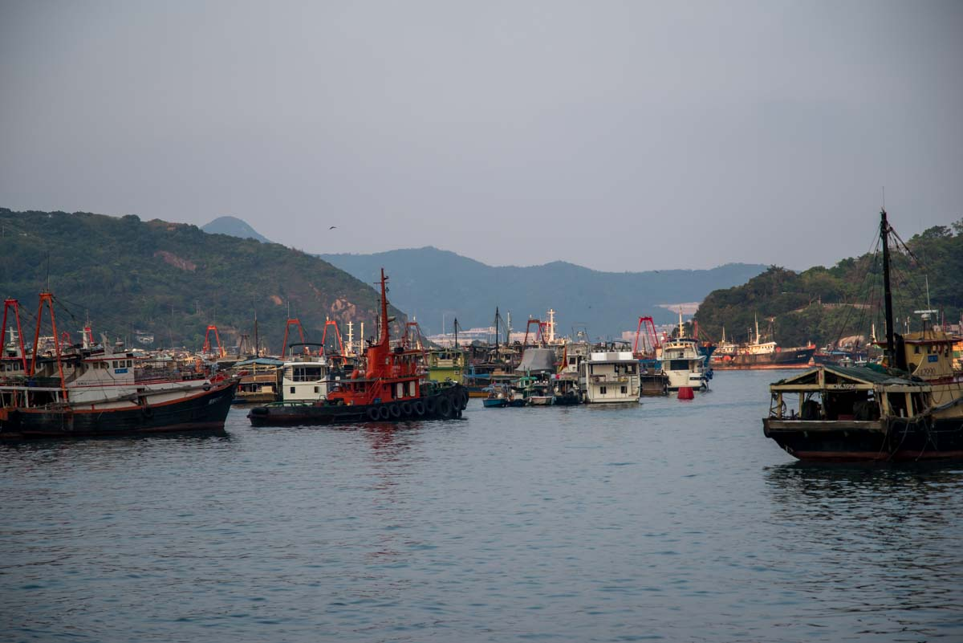
This landform is a bay. What is a bay?

Slide 15
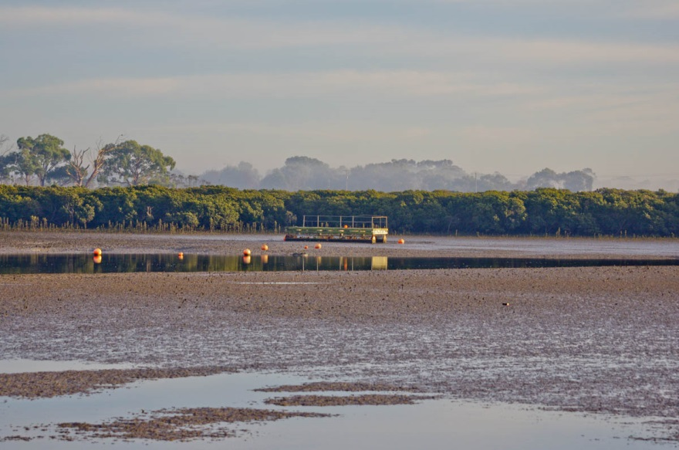
This landform is a mudflat. What would it feel like?

Slide 16
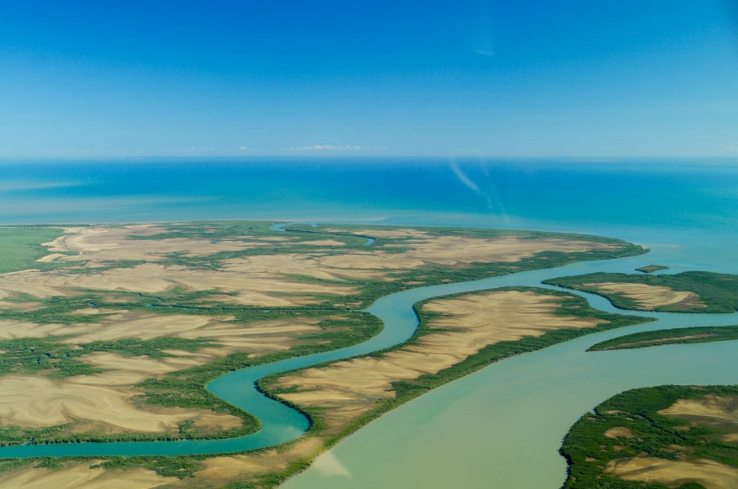
This area is covered in mudflats. What other landforms can you see?

Slide 17
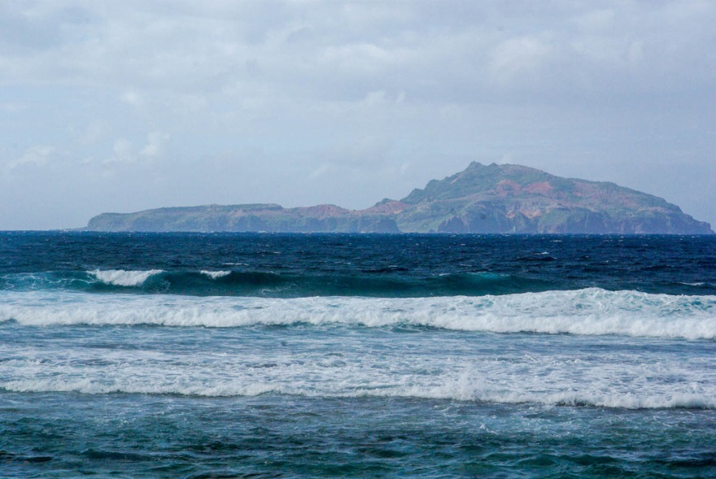
This landform is an island. What is it made from?

Slide 18
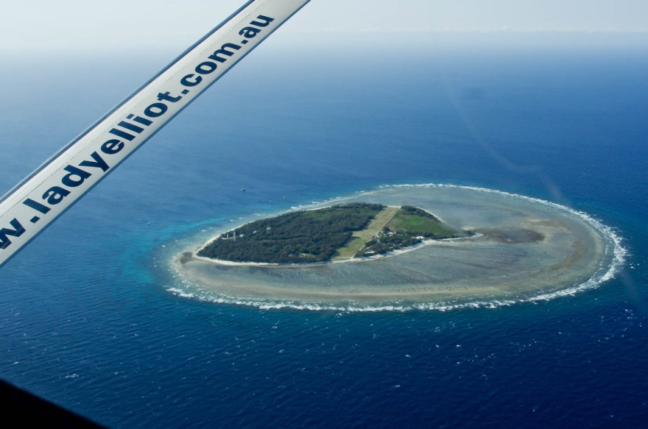
This landform is a coral cay. What is island made from?

Slide 19
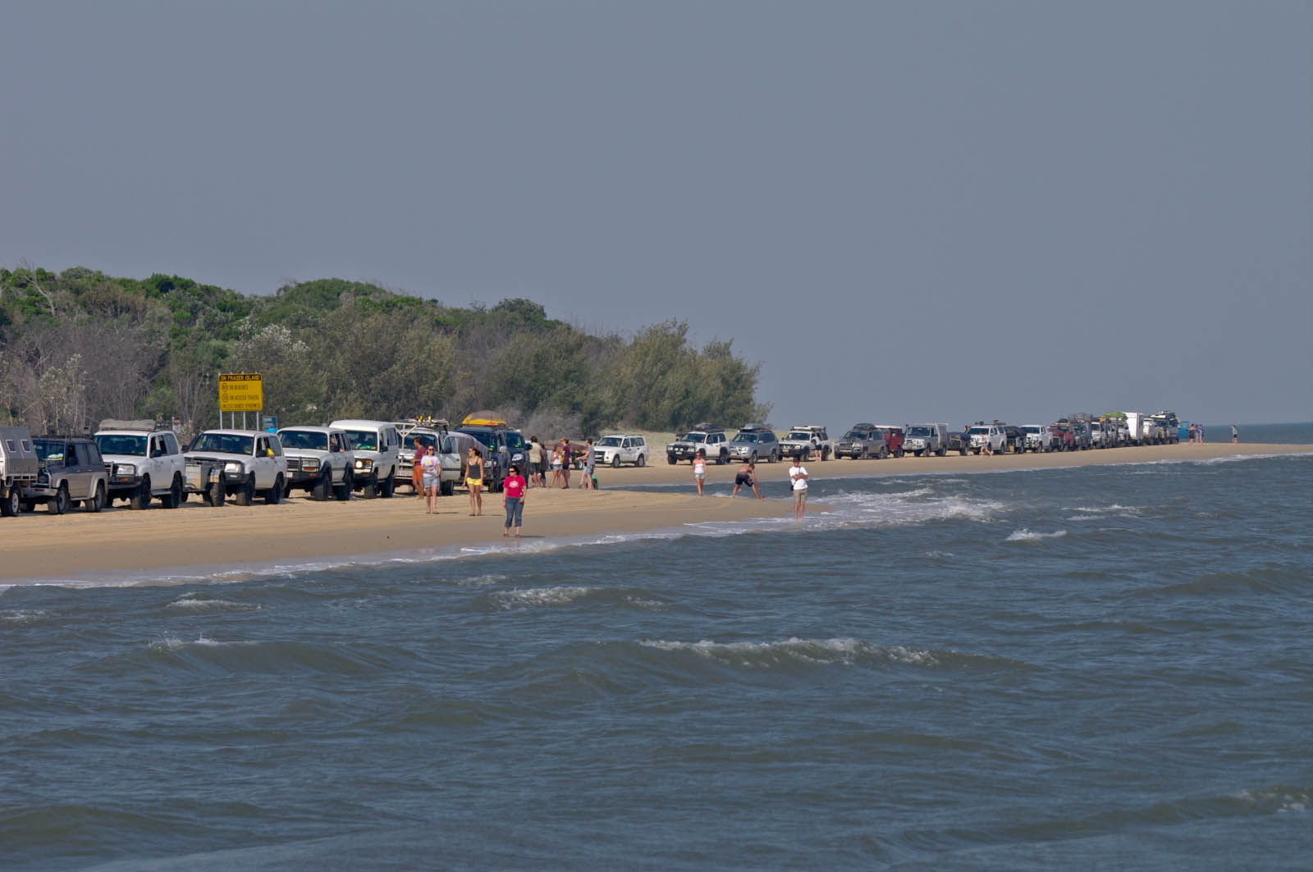
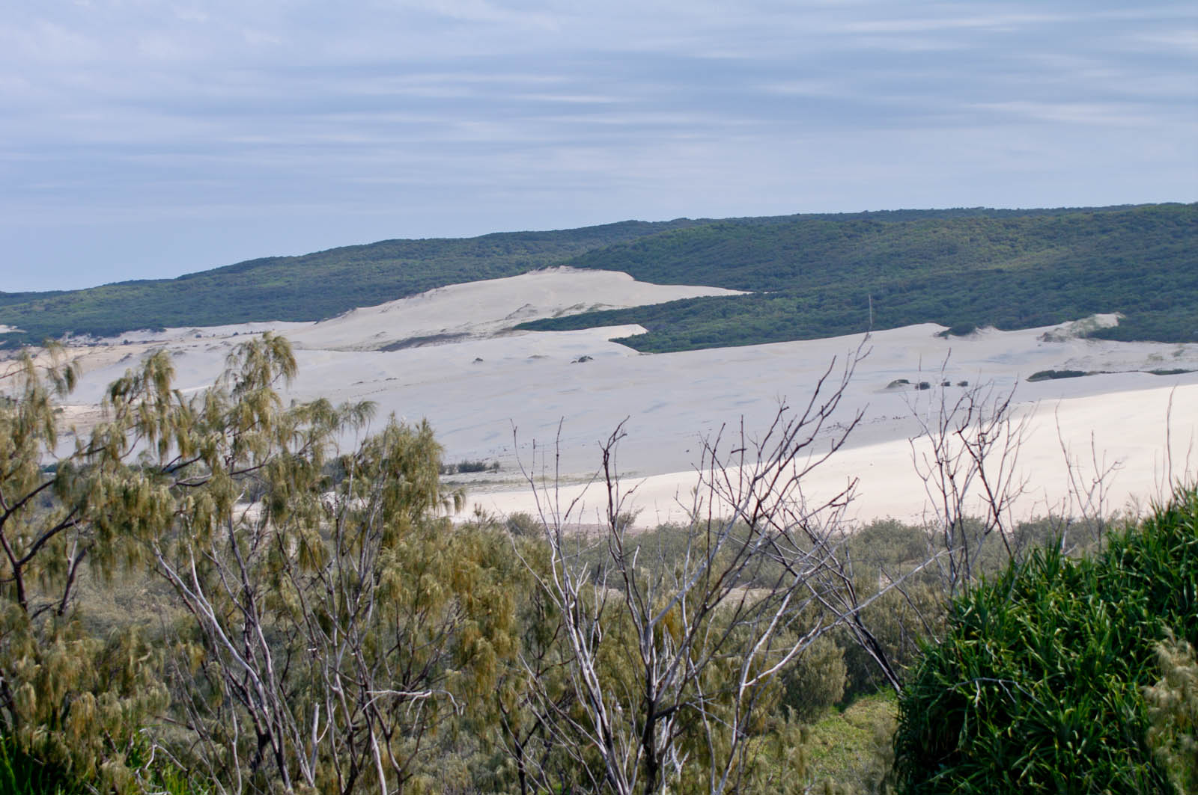
This island is called Fraser Island. What is it made from?

Slide 20
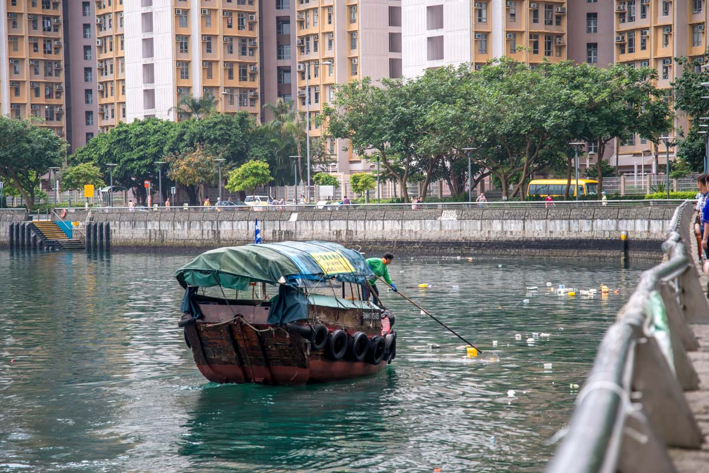
Why has the wall been constructed and not left as a beach?

Slide 21
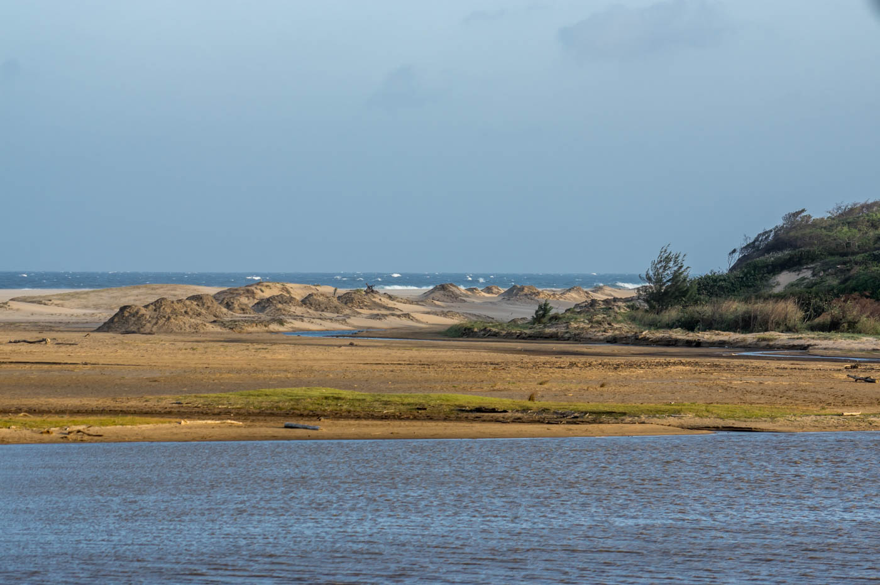
How long ago was it that Hong Kong island had beaches like this?

Slide 22
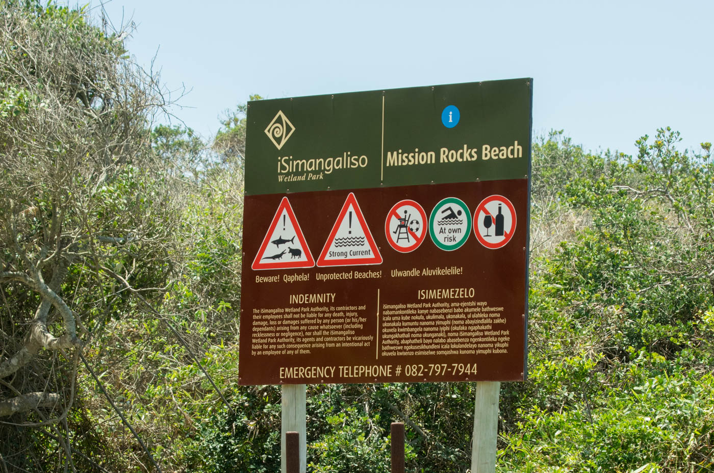
What kind of safety signs are needed for Hong Kong’s waterfront?

